Slide 1
Communication

Slide 2
Communication
Major portion of our lives in workplaces
About 70% of time
reading, writing, speaking, listening, etc.
Critical for career success

Slide 3
Communication
Definition
Transferring and understanding meaning
Perfect communication
Sender and receiver share same mental picture

Slide 4
Direction of Communication
Downward
Instruction
Repeat, seek feedback
Upward
feedback, Informing progress and problems
Prepare agenda, communicate in headlines
Lateral
Coordination
Save time vs. conflicts

Slide 5
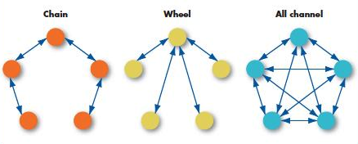
Three Common Small-Group Networks

Slide 6
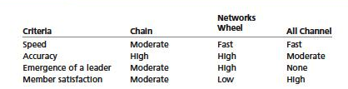
Small-Group Networks and Effective Criteria
Higher

Slide 7
Organizational Communication
Interpersonal Communication
Grapevine (rumor)

Slide 8
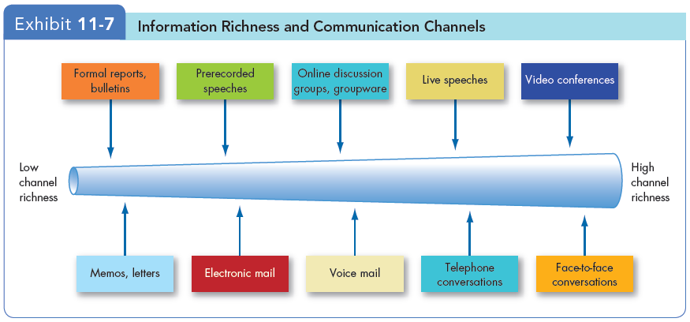
Channel Richness & Choice of Communication Method

Slide 9
Choice of Communication Channel
Channel Richness
The amount of information that can be transmitted during communication
Rich Channel
Multiple information cues
Immediate feedback
Non-verbal communication
Richer Channel is better when contents are
Ambiguous
Complicated
Non-routine

Slide 10
Global Implications
Cultural Barriers:
Semantics
No equivalent words
Connotations
Different meaning
Tone differences
Differences in methods for resolving conflicts

Slide 11
Global Implications
Cultural Barriers:
High context vs. Low context

Slide 12
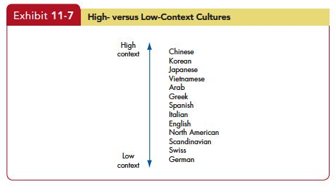
Global Implications

Slide 13
Global Implications
Cultural Barriers:
High context vs. Low context
High context cultures:
Low context cultures:

Slide 14
Global Implications
A Cultural Guide

